Slide 1

LatentView Approach – DevOps Practices in Data Science
Apr 2019

Slide 2
Agenda
1
Why DevOps?
2
LatentView’s Approach on DevOps Engagement
3
Evolution of DevOps to DataOps
4
DevOps Lifecycle, Stages, Toolchains
5
DevOps Best Practices for Data Science
6
Proposed DevOps Delivery Structure

Slide 3
Why DevOps?
DevOps is more about a culture and is a set of processes that bring development and IT operations together to complete the software development/statistical modeling package. As per State of DevOps report, key metrics are -
IT organizations deploy 200 times more frequently, with 2,555 times faster lead times
High-performing IT teams spend 50 percent less time remediating security issues
1
2
They have 24 times faster recovery times and three times lower change failure rates
And they spend 22 percent less time on unplanned work and rework
3
4
Cost Curve Post Implementation of DevOps
Benefits of DevOps
Cost
Unites agile, continuous delivery, and automation among others in helping the teams achieve greater speed, efficiency and quality while delivering higher value to customers.
Shorter development cycle, time to market
Increased cost advantage thanks to automation on CI/CD
Reduced deployment failure, time to recover
Improved communication and collaboration
Higher productivity & flexibility
Moving away from legacy to microservices leading to minimal impact to business services
Time (years)
0
1
2
Managed by LatentView
Automated

Slide 4
LatentView’s Approach on DevOps Engagement

Slide 5
LatentView’s Approach on DevOps Engagement
Our 5 steps approach for DevOps engagement…
Documenting & assessing the current practise
Scoping objectives for DevOps implementation
Understanding current development lifecycle
Creating a roadmap to implement DevOps
Measuring the overall process improvement
Understand the key business objectives & projects to formulate a strategy for DevOps adoption
In the current world, understand how the client’s development lifecycle looks like
Explore and document the steps being followed. Define KPI metrics to assess the workflow.
Design an implementation roadmap, timeline, team size, methodology, release frequency, operational structure
Measure the process through the defined KPI metrics to the business in terms of usability (uptime)
Time to market, Number of releases per week/sprint, Average time in fixing the bug & releasing the update to production
Reference KPI Metrics

Slide 6
Evolution, Lifecycle, Stages, Toolchains for DevOps

Slide 7
Evolution of DevOps to DataOps
Traditional Waterfall Model
Agile Methodology Model
DevOps Approach
Emerging Field: DataOps
Complete requirements are clear and fixed
Product definition is stable
Lack of communication between client and development team
Requirements change frequently
Development needs to be fast
Continuous feedback loop between client and development team
Requirements change frequently
Development and Operations need to be Agile
Good communication between development and operations team
DataOps is an automated, process-oriented methodology, used by analytics and data teams
Improves the quality and reduces the cycle time of data analytics.

Slide 8
What is DataOps?
DataOps is an automated, process-oriented methodology, used by analytics and data teams. It applies to the entire data lifecycle from data preparation to reporting, and recognizes the interconnected nature of the data analytics team and information technology operations.
DevOps
Data Science
DataOps
Maths, Statistics
Programming
Business Domain
Data Science
QA Testing
IT Operations
Agile Software Dev
DevOps
Data Engineers
Data Scientists
Developers & Architects
Operations
Security

Slide 9
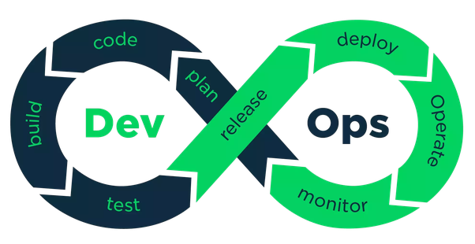
DevOps Lifecycle and Stages
DevOps Lifecycle
DevOps Stages
Continuous Development
Continuous Integration
Continuous Testing
Continuous Deployment
Continuous Monitoring
Continuous Iterations

Slide 10
DevOps – Continuous Delivery Model
Plan
Code
Build
Test
Release
Deploy
Operate
Monitor
DevOps
Continuous Deployment
Dev + Testing + Packaging + Deploying
Continuous Delivery & Release
Dev + Testing + Packaging
Continuous Testing & Integration
Dev + Testing
Continuous Development
Development using Agile Methodology

Slide 11
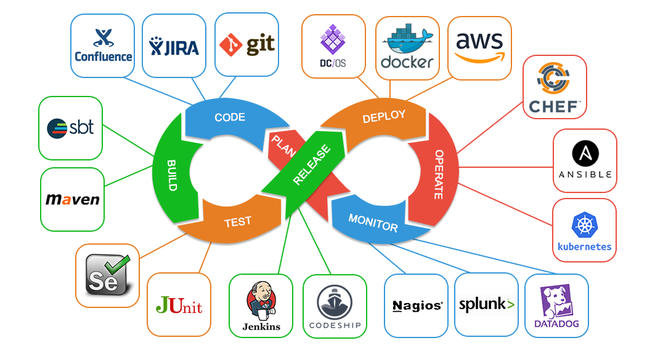
DevOps Toolchains
*more on the tools in next slide

Slide 12
DevOps Toolchains (Contd.)
S.No | Stages | Tools
1 | Plan | Project management templates/tools such as JIRA – Agile Scrum
2 | Code | Git: To manage a project, or a set of files, as they change over time. Git stores this information in a data structure called a repository JIRA Confluence: To create, share, and collaborate on projects all in one place to keep your projects moving forward, faster. Subversion: A free/open source version control system (VCS). It manages files and directories, and the changes made to them, over time. This allows you to recover older versions of your data, or examine the history of how your data changed.
3 | Build | Apache Ants: A command-line tool whose mission is to drive processes described in build files as targets and extension points dependent upon each other. Maven: Used for projects build, dependency and documentation. It simplifies the build process like ANT. Gradle: A general-purpose build tool, it allows you to build any software, because it makes few assumptions about what you're trying to build or how it should be done.
4 | Test | Selenium: A free (open source) automated testing suite for web applications across different browsers and platforms. Junit: An open source unit testing tool and used to test small/large units of code
5 | Release (CI/CD) | Jenkins: Helps to automate the non-human part of the software development process, with continuous integration and facilitating technical aspects of continuous delivery Bamboo: A continuous integration (CI) server that can be used to automate the release management for a software application, creating a continuous delivery pipeline. Hudson: One of the popularly known tools to perform Continuous Integration.

Slide 13
DevOps Toolchains (Contd.)
S.No | Stages | Tools
6 | Deploy | Docker (Container): a tool designed to make it easier to create, deploy, and run applications by using containers. Vagrant: Docker relies on containerization, while Vagrant utilizes virtualization. In other words, if you want to manage machines, you should use Vagrant and if you want to build and run application environments, you should use Docker.
7 | Operate | Chef: Manages servers – 5 or 5,000 of them – by turning your infrastructure into code. Time-consuming activities like manual patching, configuration updates, and service installations for every server will no longer exist Ansible: An open-source software provisioning, configuration management, and application deployment tool Kubernetes: An open-source container orchestration system for automating application deployment, scaling, and management. Puppet: An open-source software configuration management tool. SaltStack: Manages heterogeneous computing environments, orchestrates any cloud and automates deployment of just about any infrastructure and software stack used to create modern cloud, enterprise IT and Web scale
8 | Monitor | Nagios: A free and open source computer-software application that monitors systems, networks and infrastructure. It offers monitoring and alerting services for servers, switches, applications and services. DataDog: It is a monitoring service for cloud-scale applications, providing monitoring of servers, databases, tools, and services, through a SaaS-based data analytics platform. Monit: It is the simple “watchdog” for system monitoring and error recovery. Splunk: This software helps improve velocity, quality and the business impact of app delivery. Unlike other solutions that focus on discrete release components, Splunk provides real-time insights across all stages of the delivery lifecycle

Slide 14
Overlapping of DevOps with Data Science Workflow
Formulate Data Science Problem
Data Collection
Data Cleaning
Data Exploration
Feature Engineering
Modeling
Validation
Data Science
Iteration
Continuous Development and Integration
Continuous Building and Testing
Containers eliminate any chance of errors/ failure in production environment by packaging and replicating the same dependencies & packages used in development/ testing/ staging environment.
Ex: Docker
Continuous Deployment
Containerization/ Virtualization
Continuous Monitoring

Slide 15


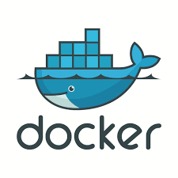
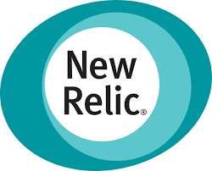

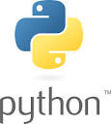
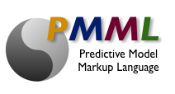
DevOps Best Practices for Data Science
Version Control
PMML
CI/CT/CD
Monitor
Security
Versions are maintained in a central repository
Developers + Operations can have access to the same code
During fault, ops can quickly rollback the deployed code and thus revert to the previous stable state.
Build Model
Check-in code
Build Deployment Package
Deploy
Monitor
DevSecOps refers to the discipline and practice of safeguarding the entire DevOps environment through strategies, policies, processes, and technology
Security should be built into every part of the DevOps lifecycle, including inception, design, build, test, release, support, maintenance, and beyond
PMML is the de facto standard to represent predictive solutions
It allows for different statistical and data mining tools to speak the same language
It may be developed in one application and directly deployed on another
Automating the process of delivering the code to Prod environment
Capitalize different types of environment: Development, Staging (Testing), Production
Canary Deployment using Load Balancing
Deploying models in Containers – Docker
Monitoring – Retrain the model during concept drift using recent data

Slide 16
Proposed DevOps Delivery Structure

Slide 17



Proposed DevOps Delivery Structure
Roles
Key Responsibilities
Adopting Agile scrum methodology for effective project management
Defining the roadmap for client’s products/services. Establish the success criteria using KPI metrics
Product Owner/ BAs/ Scrum Master
Evaluating options on scope, team size, timeline, release frequency, operational structure
Formulating, scoping, defining the sprints. Conducting periodical reviews such as sprint kick-off, daily scrum calls, retrospection etc.
Client Manager/ Engagement Manager
IT Operations’ members focus mostly on maintaining the production environment
Production Support & Maintenance #App 1
Production Support & Maintenance #App 2
…..
Operations
Developers focus on building the codebase for the identified module, unit test and integrate with overall project
Feature #1
Feature #2
Feature #3
Feature #4
…..
Developers

Slide 18
Appendix

Slide 19
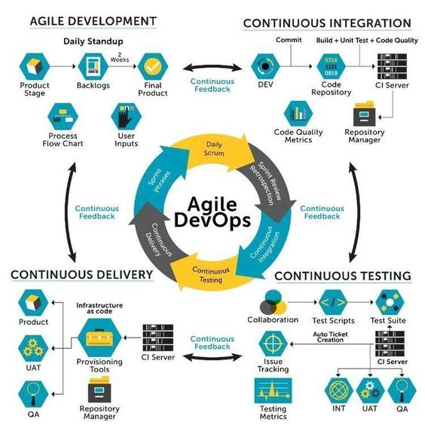
Agile Methodology into DevOps

Slide 20
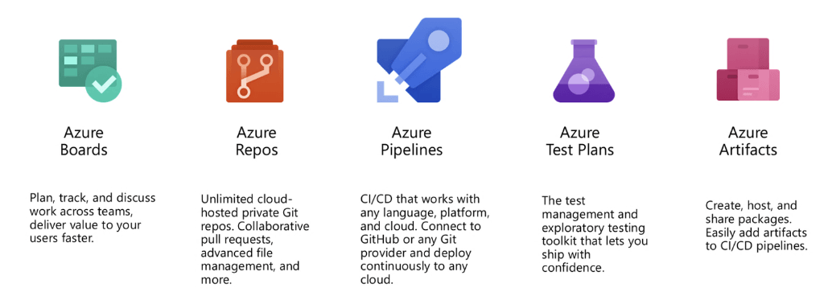
Azure Platform’s DevOps Components

Slide 21
Thank You

